Slide 1
How to build a statistical graphic
Notes:
Visualization – any way to create diagram/images/visual artifacts to communicate a message.
Statistical graphic is a type of visualization that is concerned with statistical properties of your data
Infovis when spatial representation is _chosen_ (vs given in sci-vis)
I think it’s helpful to model any data that we’ve looked at as a visualization. And before we talk about statistical graphics and visualizations,

Slide 2
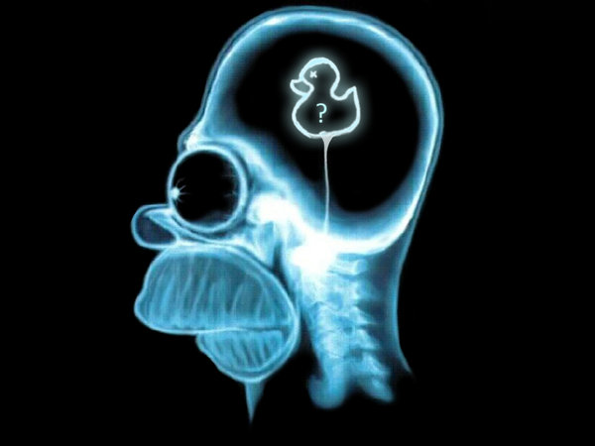

?
>
Notes:
One way to measure it could be the mass of the brain. But maybe it should depend on body mass.
So let me present to you a visualization of brain and body mass data for a number of animals

Slide 3
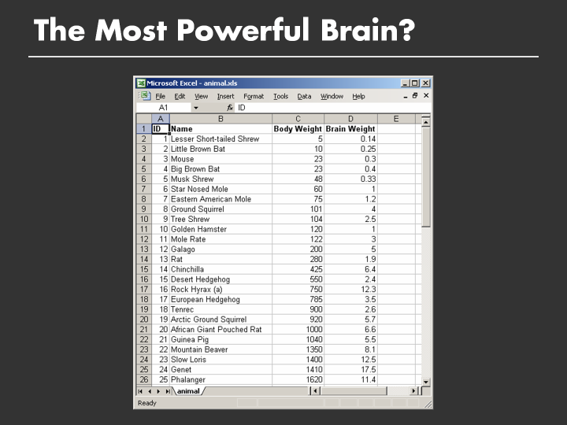
Notes:
This is a visualization of body weight to brain weight in a tabular format
However it may be difficult to reach any conclusions about what our most powerful brain is, partly because we have two numeric variables and are trying to
Compare them. In order to make any comparisons, we need to mentally pair up and sort the values individually, which is hard

Slide 4
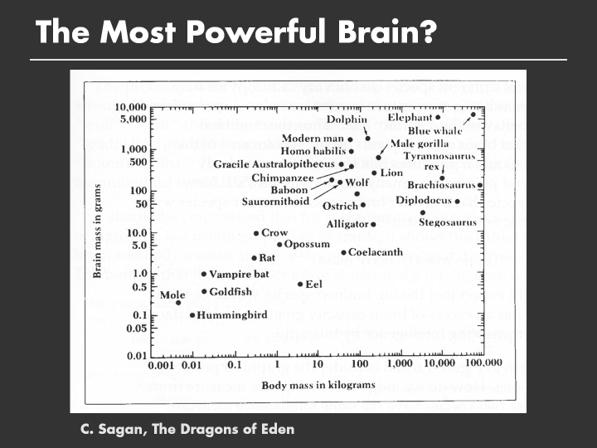
Notes:
What does this plot do better than the previous?

Slide 5
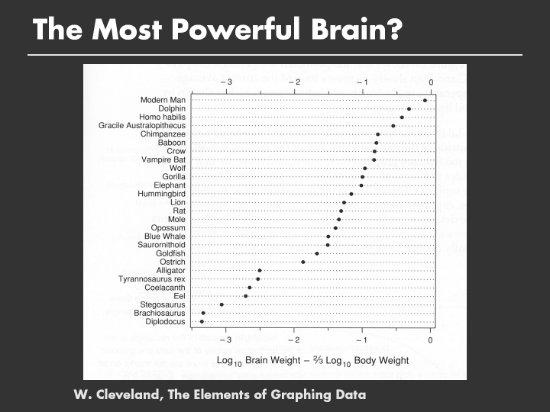
Notes:
Aaand you can lie with statistics
The reason why this visualization is so effective is
It is clear what the goal of the plot is
It is clear along what metric we are making these comparisons
The visualization helps us perform these comparisons directly
The use of ink helps and doesn’t hinder us

Slide 6
Representation of data that
eases the path to insight
Notes:
Double chocolate 1.75 10
Oatmeal raisin 10
Almond biscotti 1.75 10
Sticky buns 3.50 15
Muffin cakes 3 10

Slide 7
"Clear and precise seeing becomes as one with clear and precise thinking"
-Tufte
http://www.onlineethics.org/Topics/ProfPractice/Exemplars/BehavingWell/RB-intro/RepMisrep.aspx
Notes:
Poor representation mirrors poor reasoning and encourages and sustains it. Once we go astray in our reasoning, our visual representation not only confirms the bad reasoning which it embodies, but compounds our problems by leading us into further errors.

Slide 8
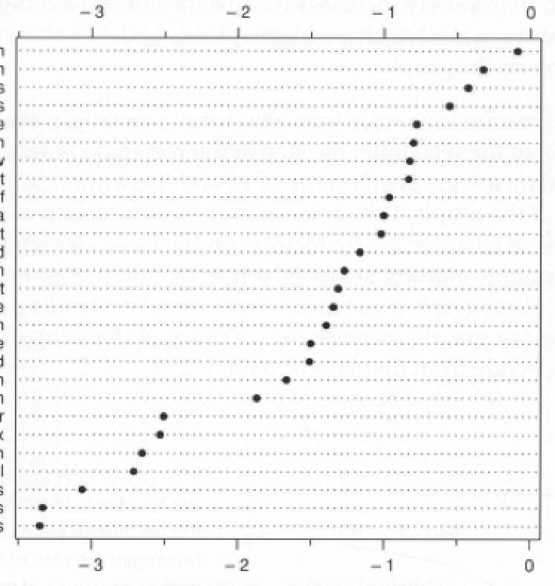
Outline
Visual Statistics
Graphical Principles
Visualization Toolkits
Tidy
Data

Slide 9
Tidy data
Each variable forms a column
Each observation forms a row
Each table stores info about one observational type
Hadley Wickham
Notes:
Almost all visualization tools assume the data comes in a tidy form. This is different than csv, tsv, excel etc, but the nature of the data.

Slide 10
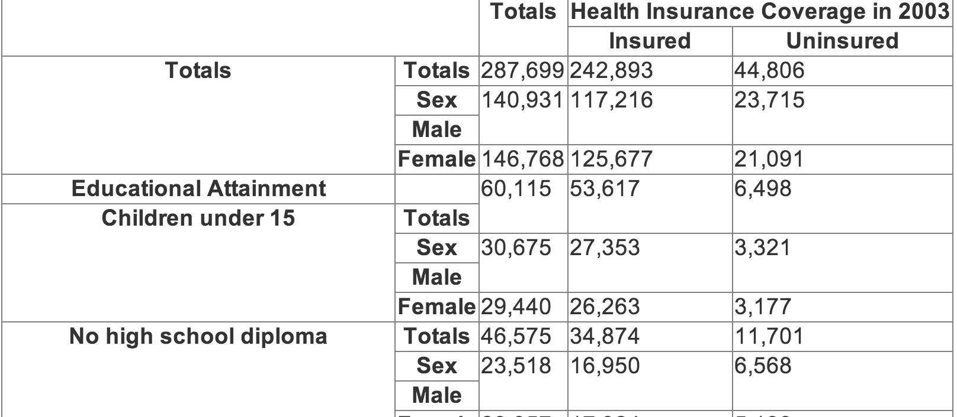
Maybe use previously seen dataset
Notes:
This is a census report of insured people by education.
This is a report, not tidy data
The totals are computed aggregates, and are mixed together with individual observations

Slide 11
Education | Gender | Insurance | Count
Under 15 | Male | yes | 27353
Under 15 | Male | no | 3321
Under 15 | Female | yes | 26263
Under 15 | Female | no | 3321
No HS | Male | yes | 16950
No HS | Male | no | 6568
Notes:
This is a census report of insured people by education.
This is a report, not tidy data
The totals are computed aggregates, and are mixed together with individual observations

Slide 12
How to tell a story with data?
Quantify with statistics
Explain with visualizations
Statistical
Visualizations

Slide 13
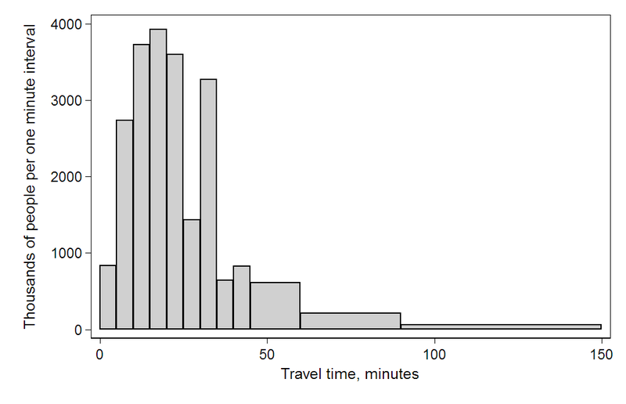
Statistics is about distributions
Notes:
https://en.wikipedia.org/wiki/File:Travel_time_histogram_total_n_Stata.png

Slide 14
summarizing distribution w/ numbers summarizing distribution w/ trends comparing distributions correlating distributions

Slide 15
Summarize me
Notes:
https://en.wikipedia.org/wiki/File:Travel_time_histogram_total_n_Stata.png
Average? Median? 90th percentile? Skew? Std dev?

Slide 16
Quantifying uncertainty
US avg.
(6.885)
US avg.
(census)
0
minutes spent commuting
Notes:
How to quantify this

Slide 17
summarizing distribution w/ numbers summarizing distribution w/ trends comparing distributions correlating distributions

Slide 18
Distributional Trends

Slide 19
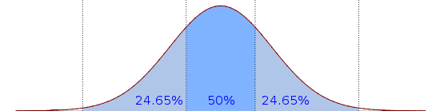
Distributional trends

Slide 20
Median
Notes:
https://en.wikipedia.org/wiki/File:Boxplot_vs_PDF.svg

Slide 21
25%
75%
Notes:
https://en.wikipedia.org/wiki/File:Boxplot_vs_PDF.svg

Slide 22
Inner Quartile Range
Notes:
https://en.wikipedia.org/wiki/File:Boxplot_vs_PDF.svg

Slide 23
Whiskers / Extremes
Notes:
https://en.wikipedia.org/wiki/File:Boxplot_vs_PDF.svg

Slide 24
Outliers
Notes:
https://en.wikipedia.org/wiki/File:Boxplot_vs_PDF.svg
----- Meeting Notes (1/9/12 16:23) -----
make arrows shorter

Slide 25
Box-and-Whiskers Plot

Slide 26
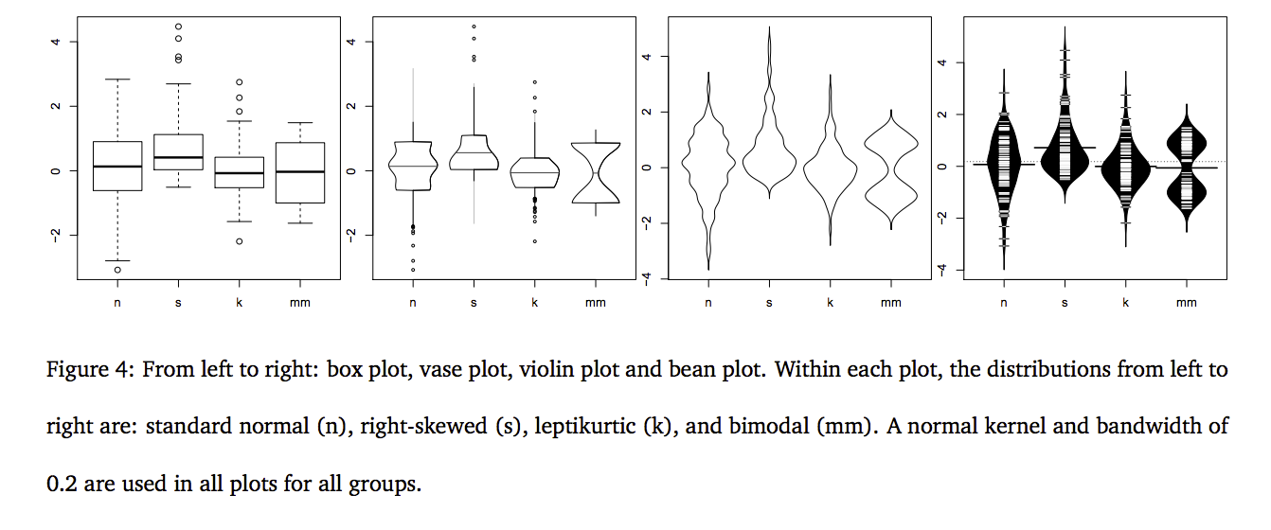
from http://vita.had.co.nz/papers/boxplots.pdf
Notes:
http://vita.had.co.nz/papers/boxplots.pdf
But sometimes you just want to show the whole distribution

Slide 27
summarizing distribution w/ numbers summarizing distribution w/ trends comparing distributions correlating distributions

Slide 28
Commute time MIT vs. USA
minutes spent commuting
USA
MIT
USA
MIT
0

Slide 29
summarizing distribution w/ numbers summarizing distribution w/ trends comparing distributions correlating distributions

Slide 30
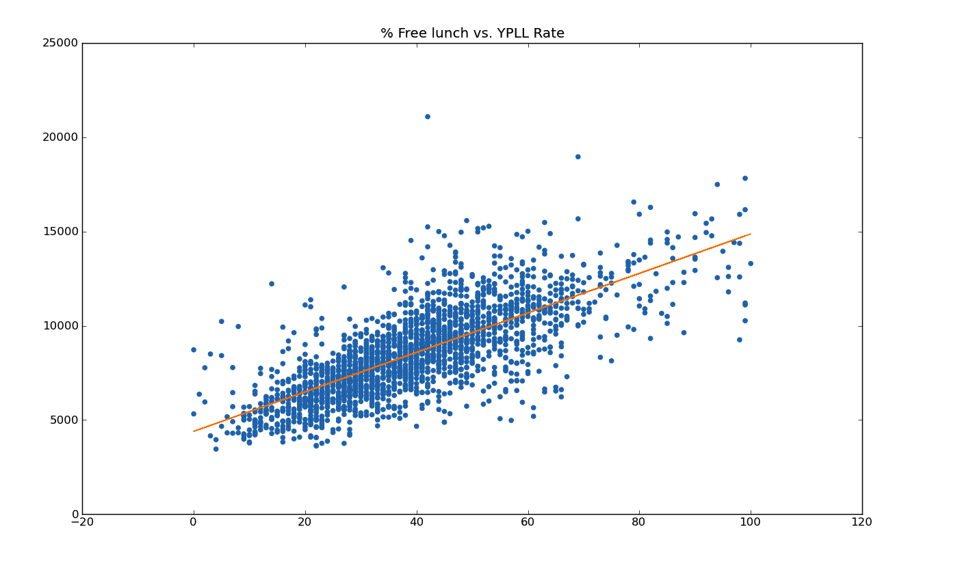
Terribleness of Life
% free lunch

Slide 31
summarizing distribution w/ numbers summarizing distribution w/ trends comparing distributions correlating distributions

Slide 32
visual analogs to statistics complex groupings

Slide 33
Visual analogs to statistics
t-test
regression/correlation
Notes:
And others! Conditioning vs. Brushing: http://bl.ocks.org/mbostock/4063663

Slide 34
Most viz you’ve seen so
far is oversimplified

Slide 35
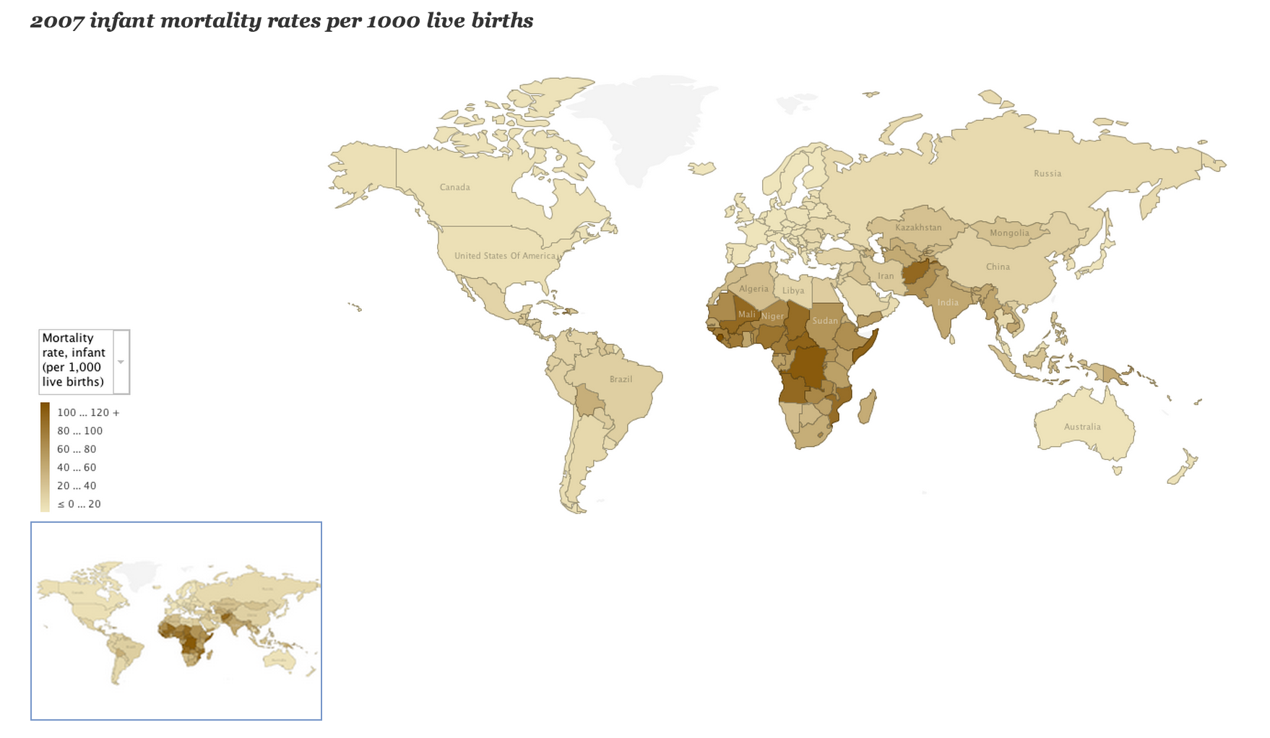
Notes:
http://blogs.ubc.ca/datavis/2012/04/02/horn-of-africa-data-visualizations-for-nytimes-article-kim-nursall-heather-roy/
Tension between complex quantitative analysis and complex groupings: here we focus on complex geographic groupings, but have a simple statistic per group.

Slide 36
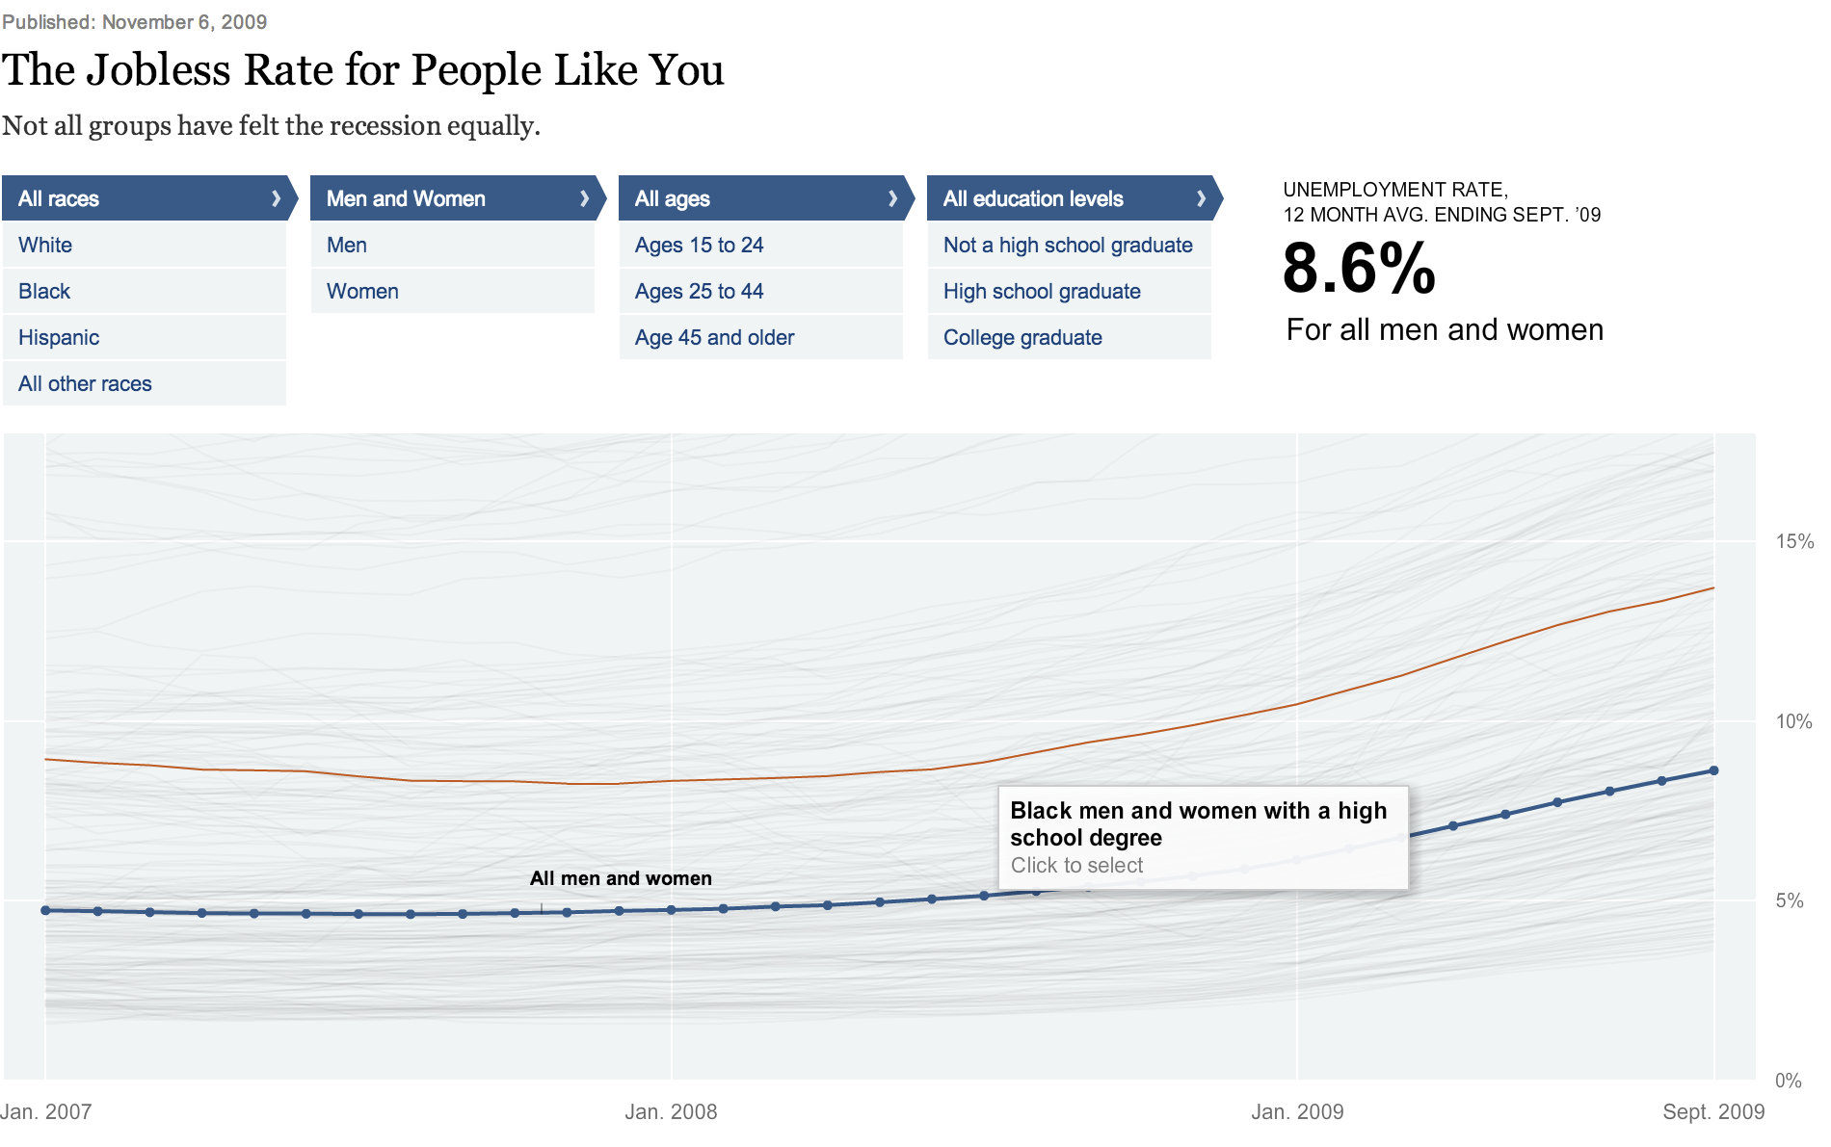
Notes:
http://www.nytimes.com/interactive/2009/11/06/business/economy/unemployment-lines.html?pagewanted=all
So many groups, so keep the visualization of each group small: a trend line

Slide 37
Graphical Principles
Make the data stand out
Don’t obscure it
Avoid superfluity
Clutter/Chart Junk
Notes:
Marketing obscures
Marks and graphical labels obscure
Spacing obscures
Multiple messages obscure
Show you many graphics, describe the goal and discuss how the data is being obscured

Slide 38
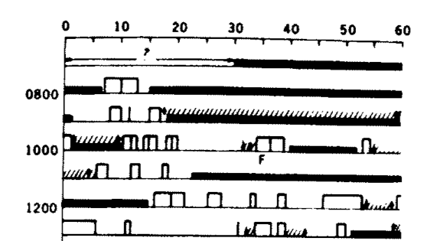
Notes:
!Kung (african tribe from botswana and namibia). Long interval between births, interesting because no birth control nor abortions
Harvard anthropologists (Melvin Konner and Carol Worthman) suggests its because of very frequent nursing in first 1-2 years of life. Nursing secretes prolactin, which reduces gonad functions – natural birth control
Open bar = nursing
Closed = baby sleeping
F = fretting
/// = holding
Arrows for picking up/down

Slide 39
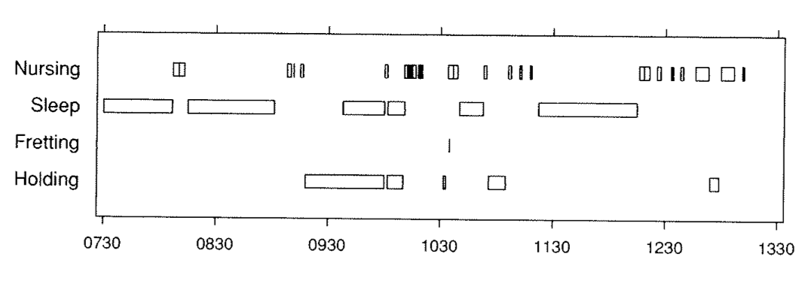
Notes:
!Kung (african tribe from botswana and namibia). Long interval between births, interesting because no birth control nor abortions
Harvard anthropologists (Melvin Konner and Carol Worthman) suggests its because of very frequent nursing in first 1-2 years of life. Nursing secretes prolactin, which reduces gonad functions – natural birth control
Open bar = nursing
Closed = baby sleeping
F = fretting
/// = holding
Arrows for picking up/down

Slide 40
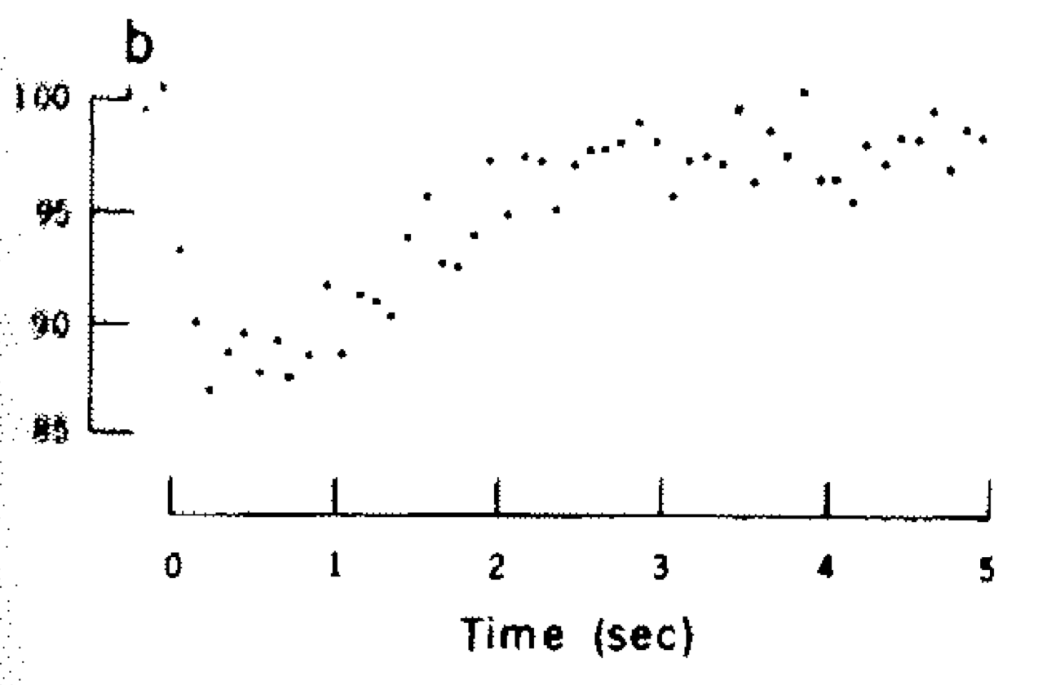
Notes:
The axes and other non-data components (legends, reference lines, adornments) can obscure the data

Slide 42
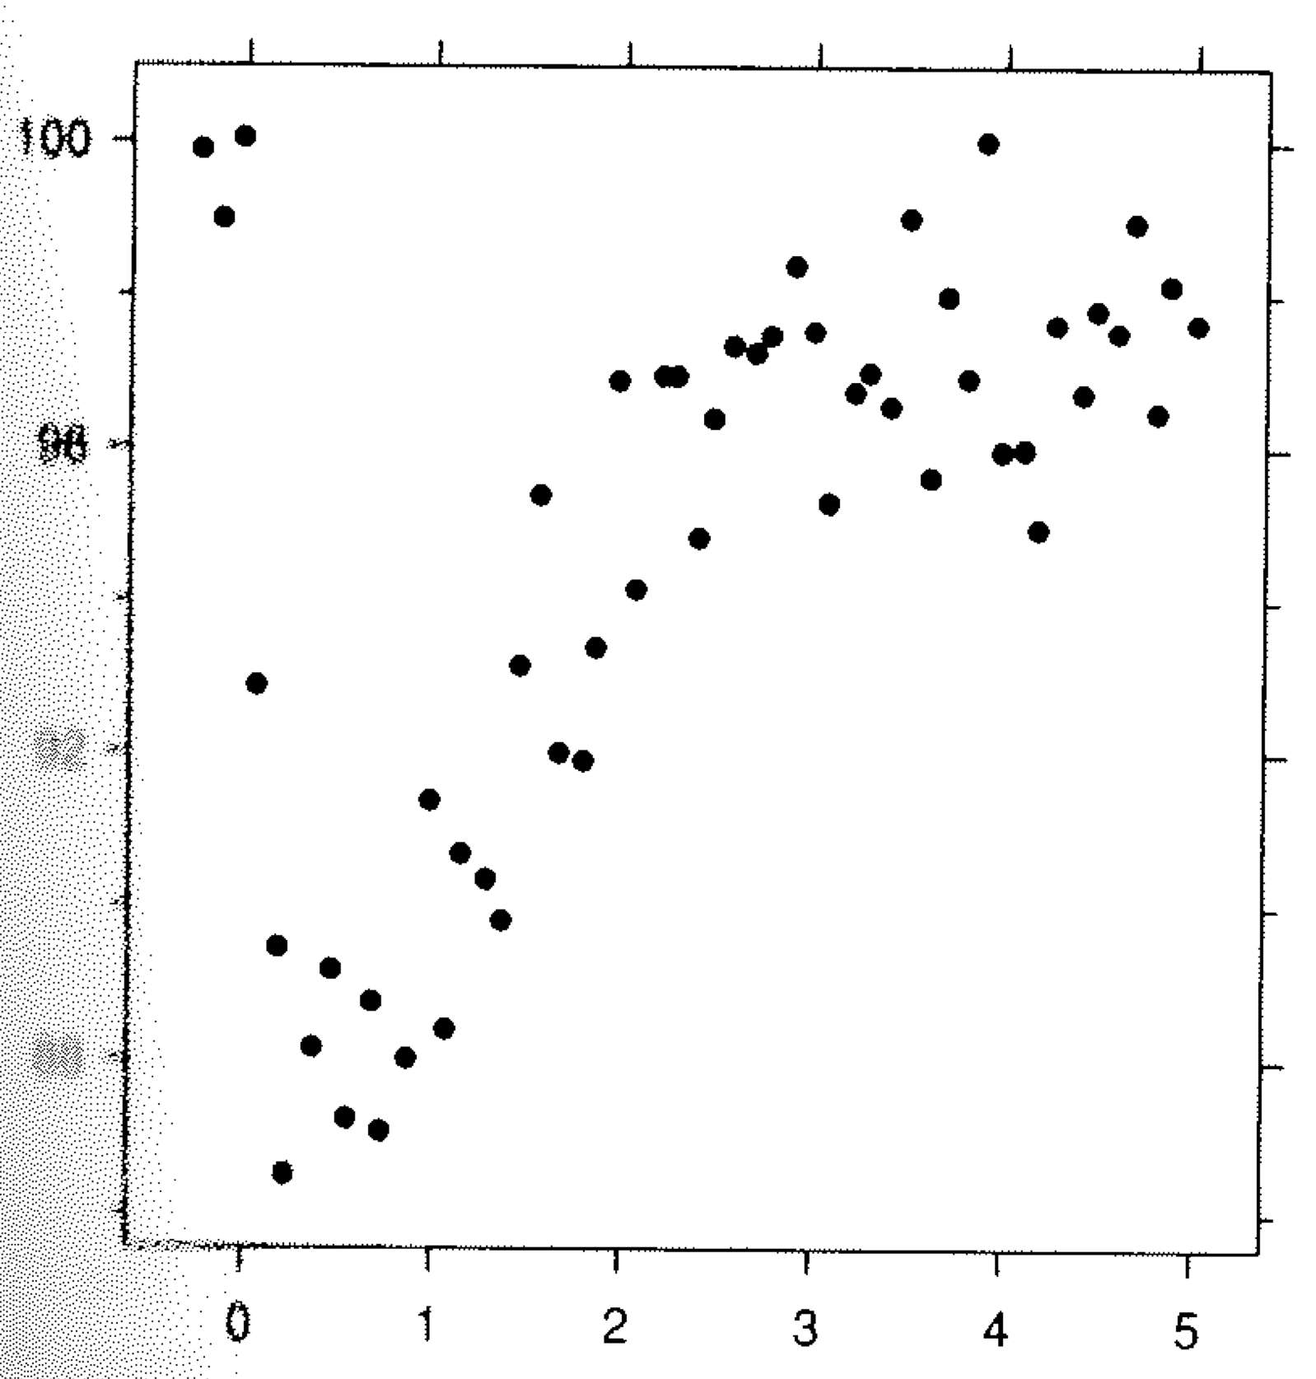

Slide 43
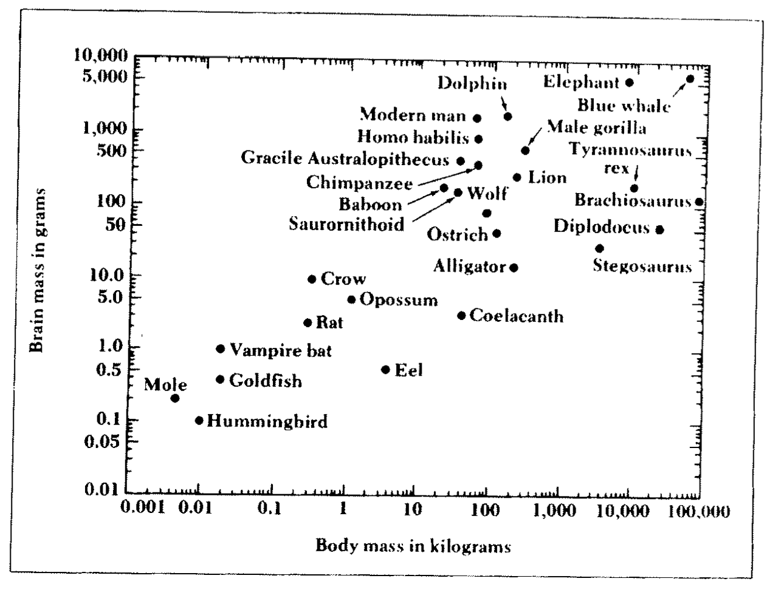
Notes:
Different attributes of the data (in this case the labels) are obscuring the numerical data. But we can’t just remove the labels, because they’re important
Reducing the amount of info helps make it clear

Slide 44
Notes:
The labels are important

Slide 45
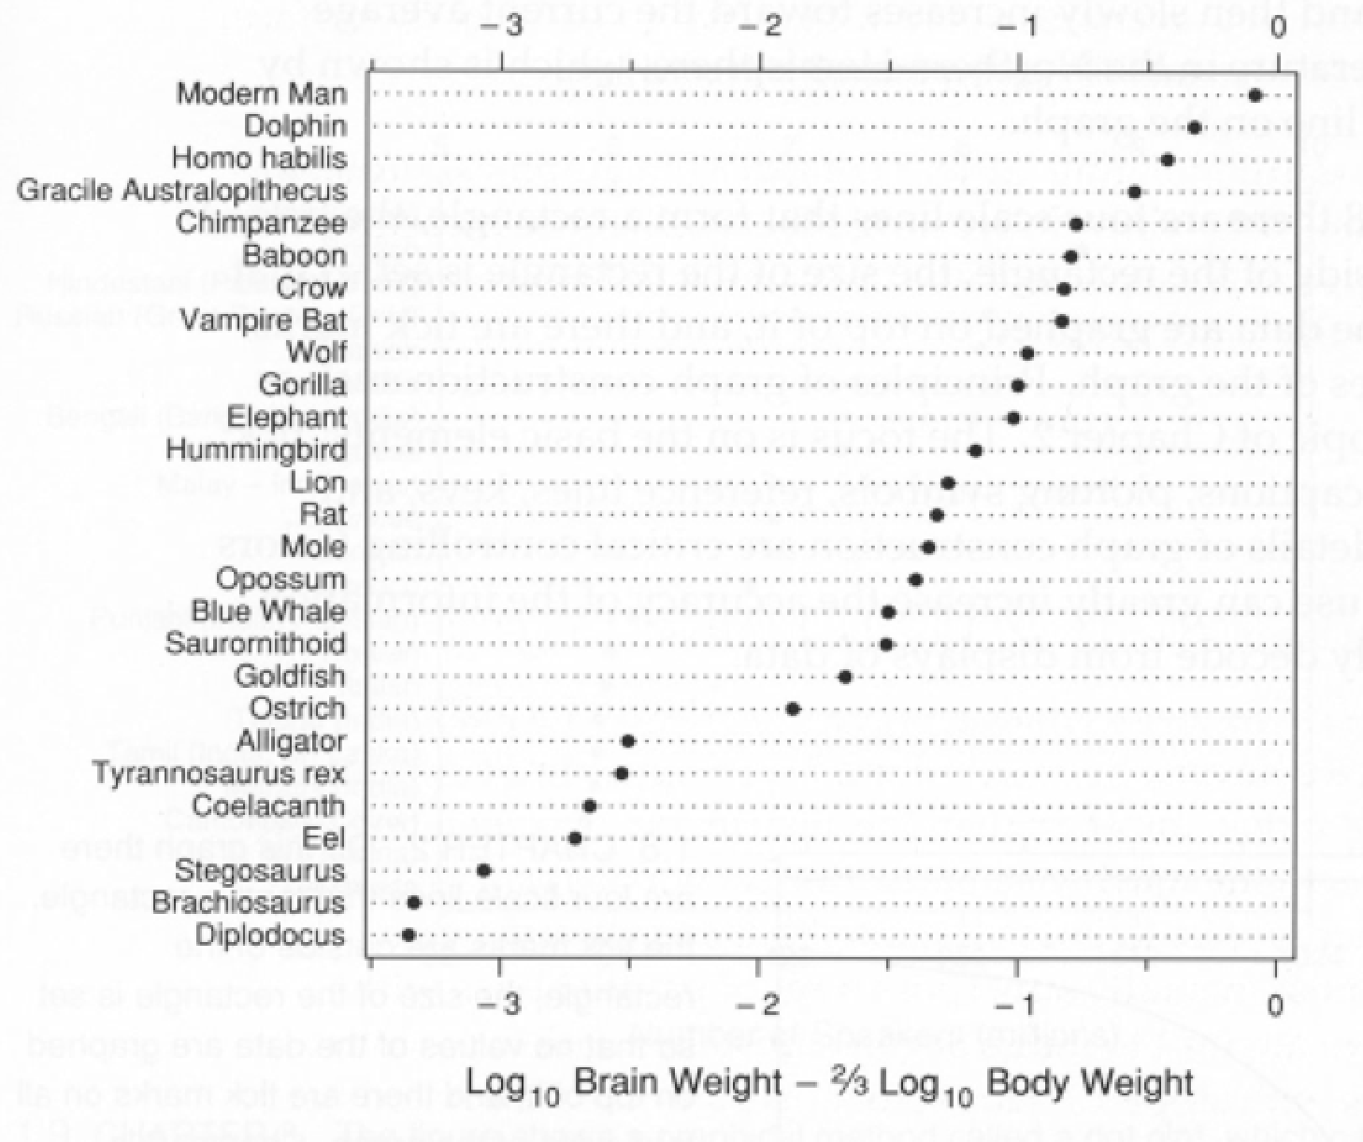
Notes:
That’s an example where the dimensionality is causing the data to be obscured

Slide 46
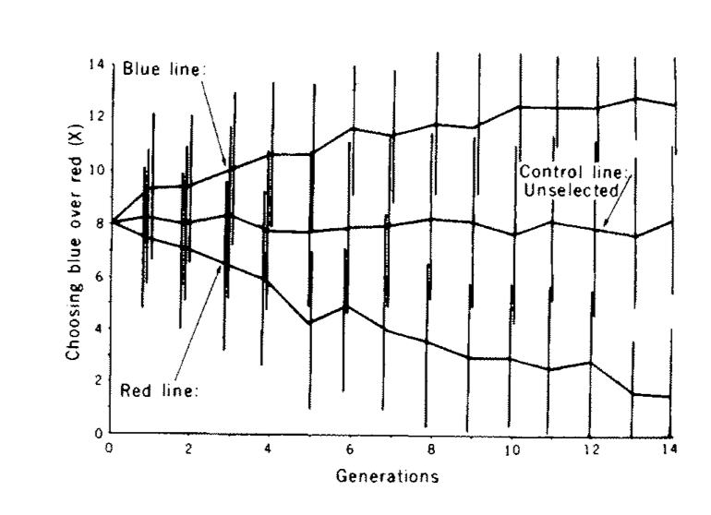
Notes:
This an example where different messages can obscure each other.
In this graph we’re plotting red, blue and control lines for an experiment (presumably yeast cells – generations)
And since this is science we should indicate the amount of uncertainty, which are the vertical bars
What can we do?

Slide 47
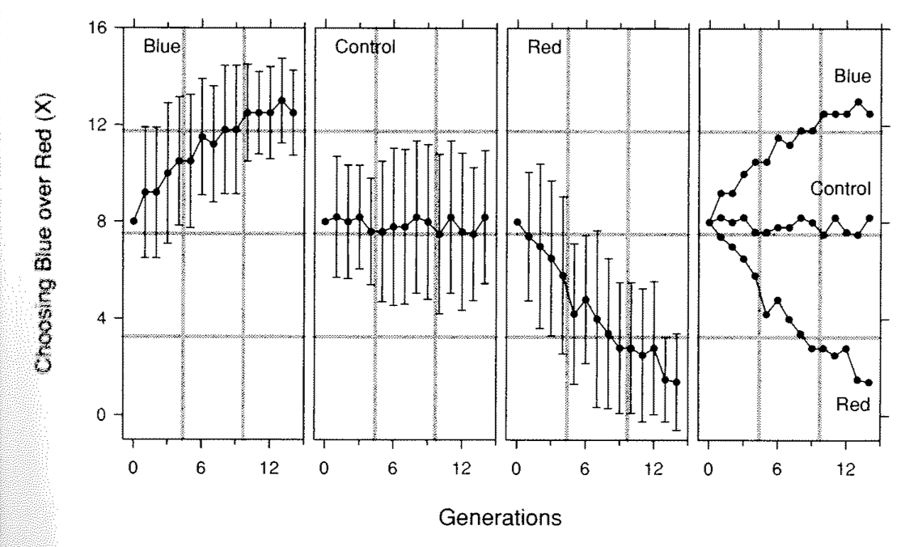
Comparative
Uncertainty

Slide 48
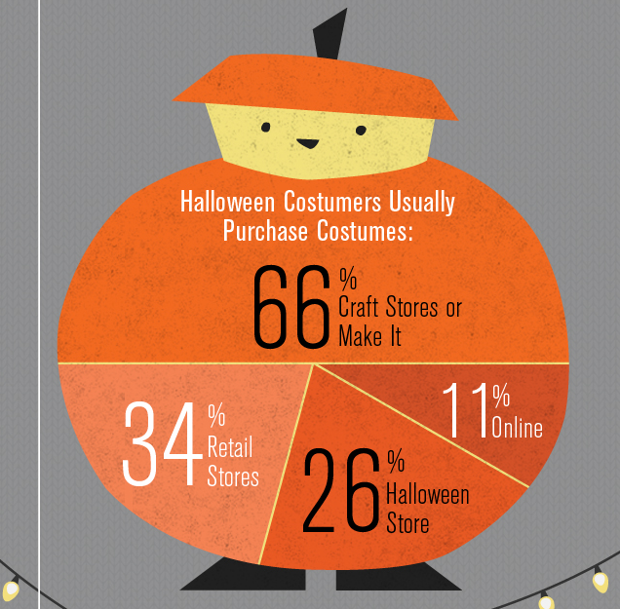
http://wtfviz.net/
Notes:
Finally this is an example where adornment completely supercedes the data. I’m not completely against pie charts
This is a spectrum of cuteness and usefulness

Slide 49
“Use definite, specific, concrete language”
“Do not overwrite”
-Elements of Style

Slide 50
“Use definite, specific, concrete language”
“Do not overwrite”
-Elements of Style
1 message/graphic
Data >> Marketing

Slide 51
Graphical Principles
Make the data stand out
Don’t obscure it
Avoid superfluity
Clutter/Chart Junk
Is the data accurately perceived?
data → perceptual mapping
Notes:
Marketing obscures
Marks and graphical labels obscure
Spacing obscures
Multiple messages obscure
Show you many graphics, describe the goal and discuss how the data is being obscured

Slide 52
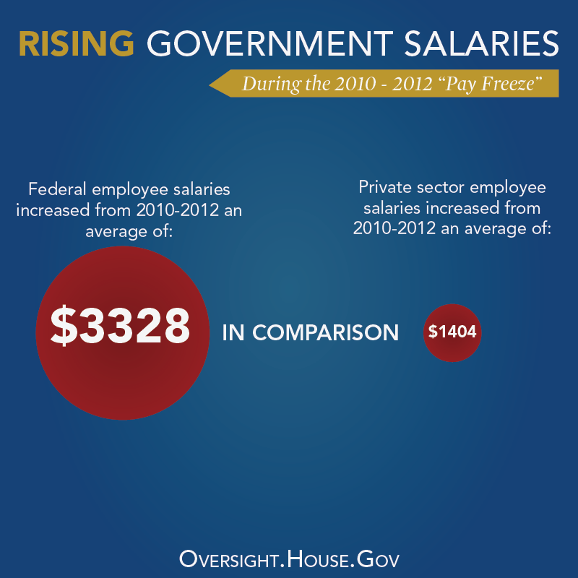
Notes:
2.37037

Slide 53
Notes:
2.37037

Slide 54
Notes:
2.37037

Slide 55
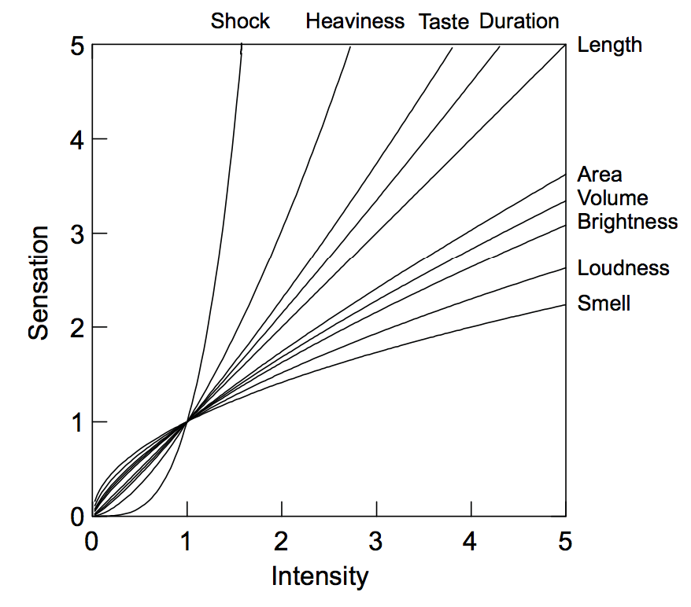
S = kI^{p}
Notes:
It started in the 1860s and came back around 1950s
X axis is data value difference, Y is perceived difference
So you can think about how different magnitudes of numerical
data can be mapped onto visual or even non visual aesthetic
power-function psychophysical curves for a variety of stimuli using data from Shiffman (1990), Stevens (1961), and other sources. Note that electric shock has an exponent greater than 3. For this and other reasons, shock would not be a good aesthetic candidate for repre- senting a dimension in a statistical graphic.

Slide 56
Length
Position
Length
Angle
Area
Volume
Color
Text
2
4

Slide 57
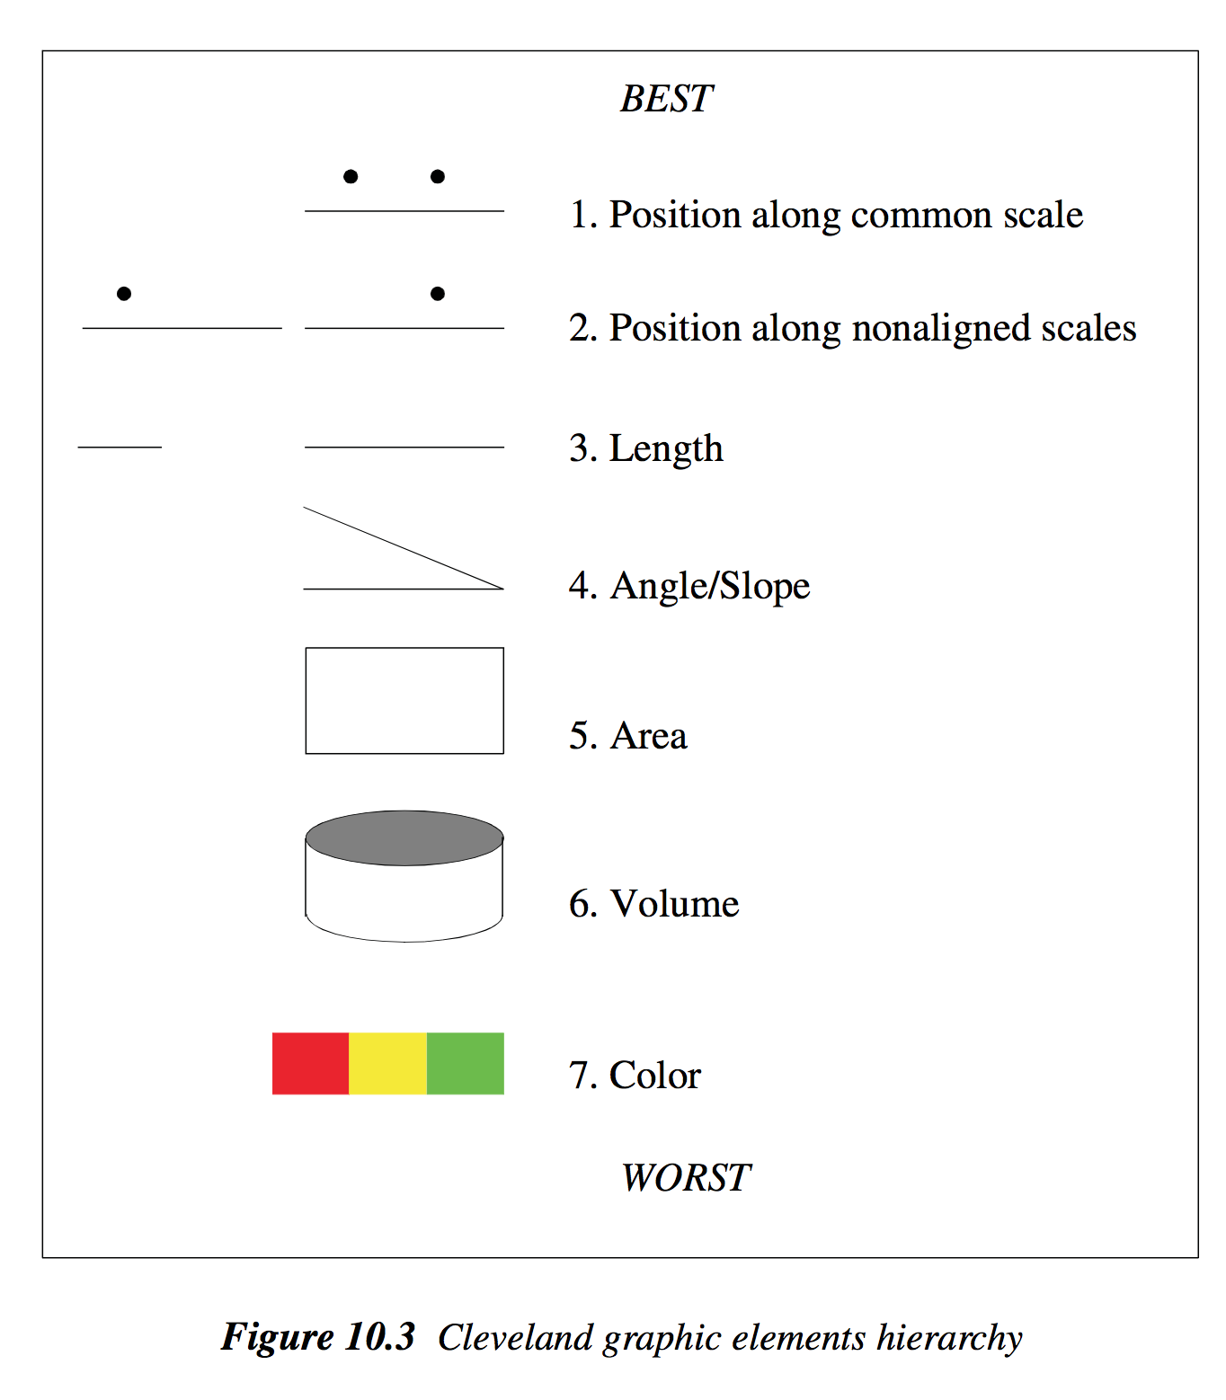

Slide 58
Exporting our mental processing
Comparing
Sorting/grouping
Scaling/normalizing
Cleaning
Summarizing statistics
Model fitting

Slide 59
Visualization Toolkit Models
Component
Grammar
D3.js
HTML/DOM

Slide 60
Component model
Bar Chart
Line Chart
Munged
Data
Renderer
Stacked Line Chart
Pie Chart

Slide 61
Component model
Bar Chart
Learn data domain
Render bars, axes, legend
Map data → bar attributes
Add interaction (hover)
Munged
Data
Renderer
Notes:
What’s great about the component model?
Really easy to use (if it does what you want)
What some issues with the component model?
Stuck with their implementation
Only emcompasses the rendering portion of the pipeline
Structured data transformations, scaling, changing data types, layouts, are all difficult to achieve
Black box

Slide 62
Demo!

Slide 63
Until 1900, hand-drawn visualizations were the method for “statistical” data analysis
Early 1900s focused on precision and quantification
Pain to draw graphs, ANOVA techniques more precise

Slide 64
Visualization Toolkit Models
Component
Grammar
D3.js
HTML/DOM

Slide 65
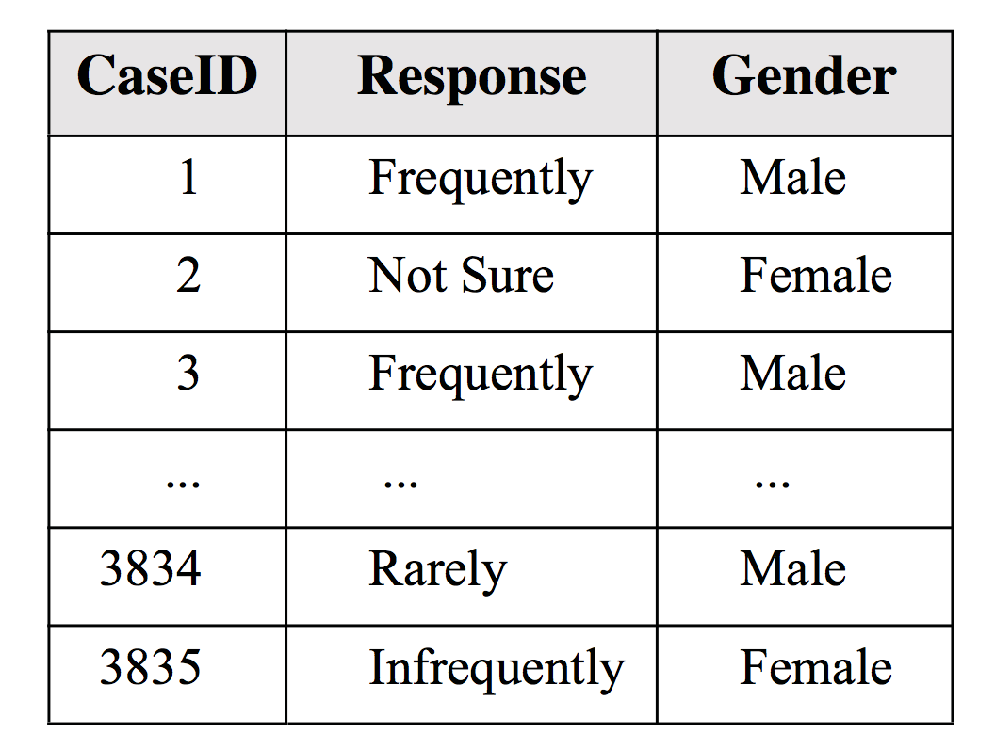
Data

Slide 66
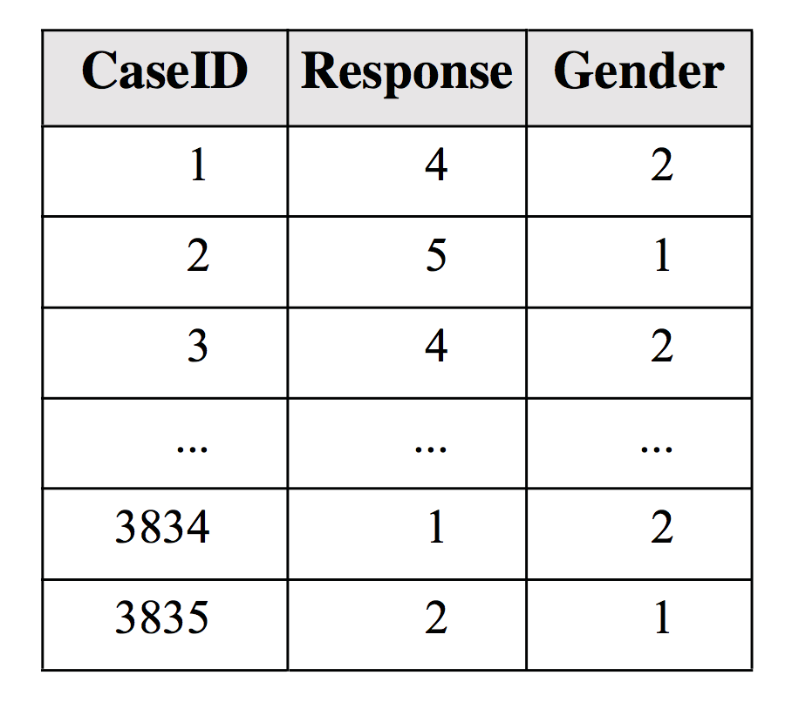
Data
Scales
Response: categorical
Gender: categorical
Notes:
May want to count the number of each gender’s response (female saying “frequently”) etc

Slide 67
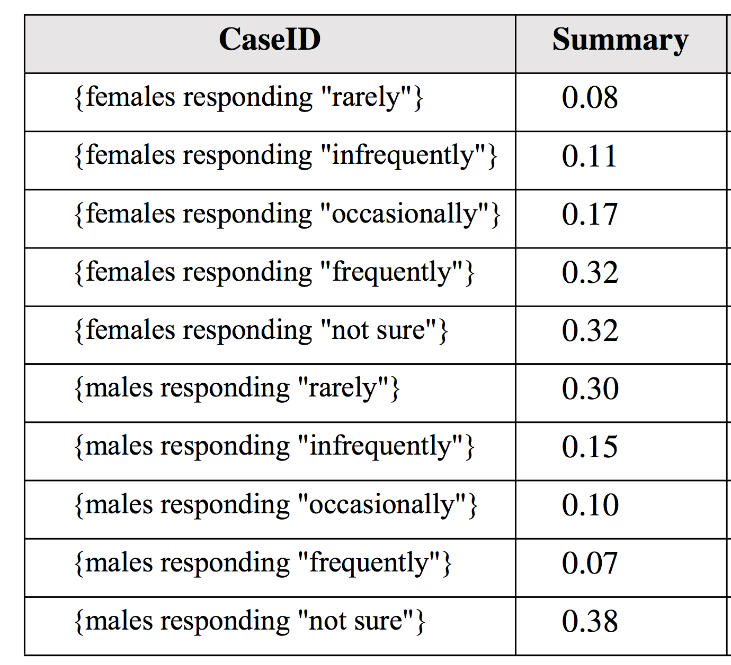
Data
Scales
Response: categorical
Gender: categorical
Statistical Transform
Bin
Notes:
The next step is to map the summary to transform this numerical statistic into the pixel domain

Slide 68
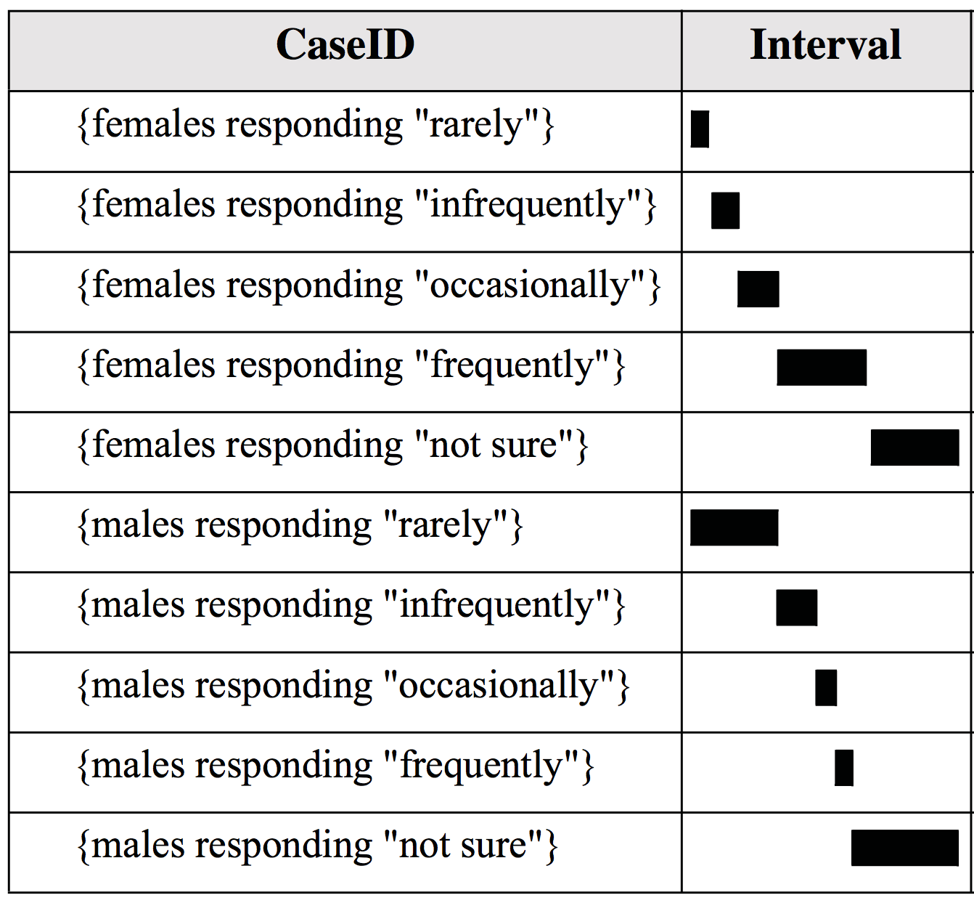
Data
Scales
Response: categorical
Gender: categorical
Statistical Transform
Bin
Geometry Mapping
Data → Interval
Notes:
Intervals are objects with a start and end
SKIPPED POSITIONING AND GROUPING

Slide 69
Data
Scales
Response: categorical
Gender: categorical
Statistical Transform
Bin
Geometry Mapping
Data → Interval
Positioning
Stacked
Notes:
Intervals are objects with a start and end
SKIPPED POSITIONING AND GROUPING

Slide 70
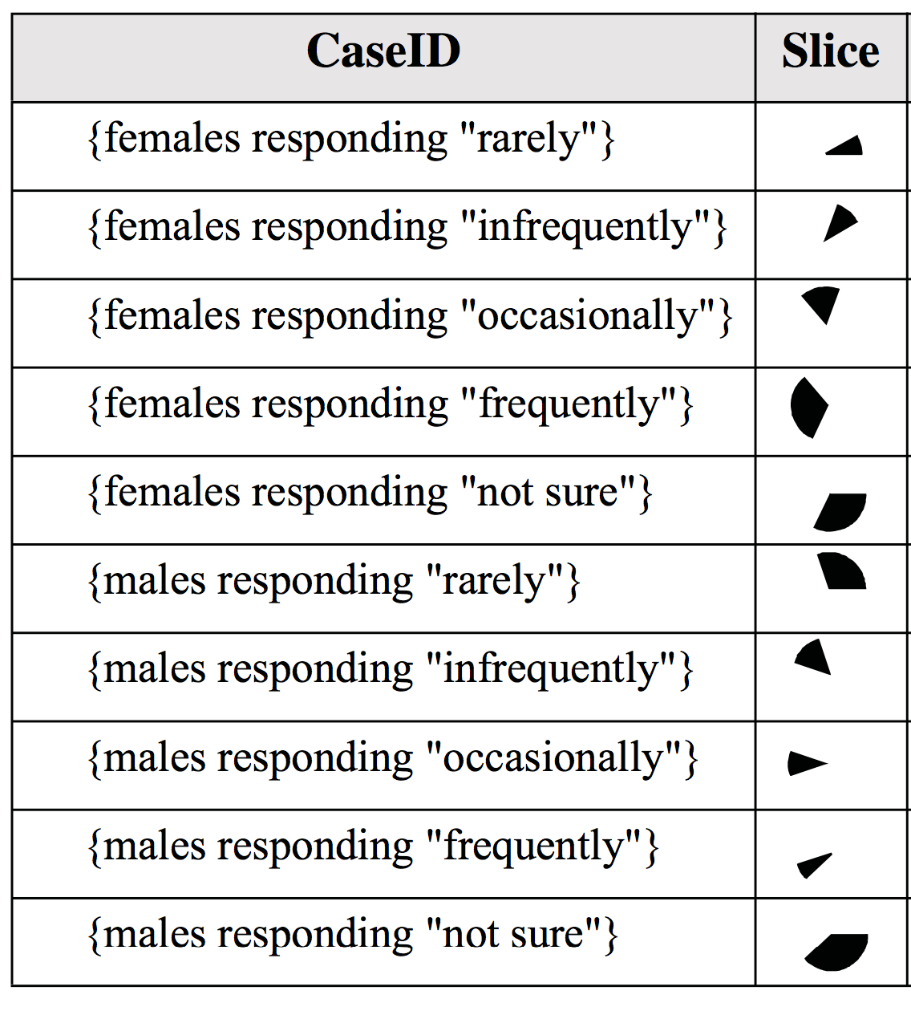
Data
Scales
Response: categorical
Gender: categorical
Statistical Transform
Bin
Geometry Mapping
Data → Interval
Positioning
Stacked
Coordinates
Euclidian → Polar

Slide 71
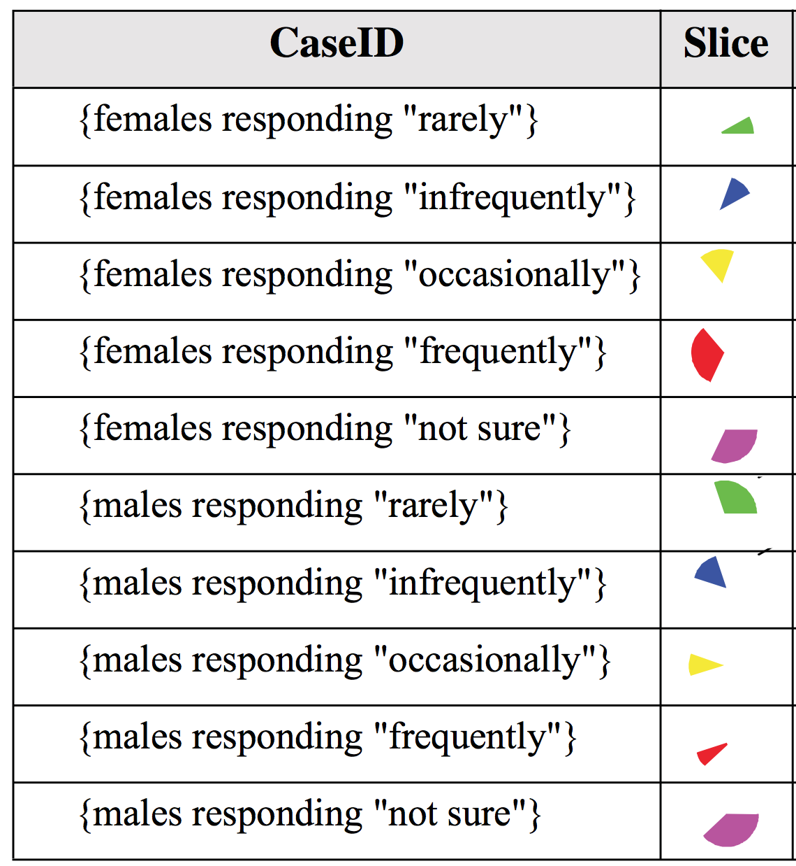
Data
Scales
Response: categorical
Gender: categorical
Statistical Transform
Bin
Geometry Mapping
Data → Interval
Positioning
Stacked
Coordinates
Euclidian → Polar
Aesthetic Mappings
Color: Response

Slide 72
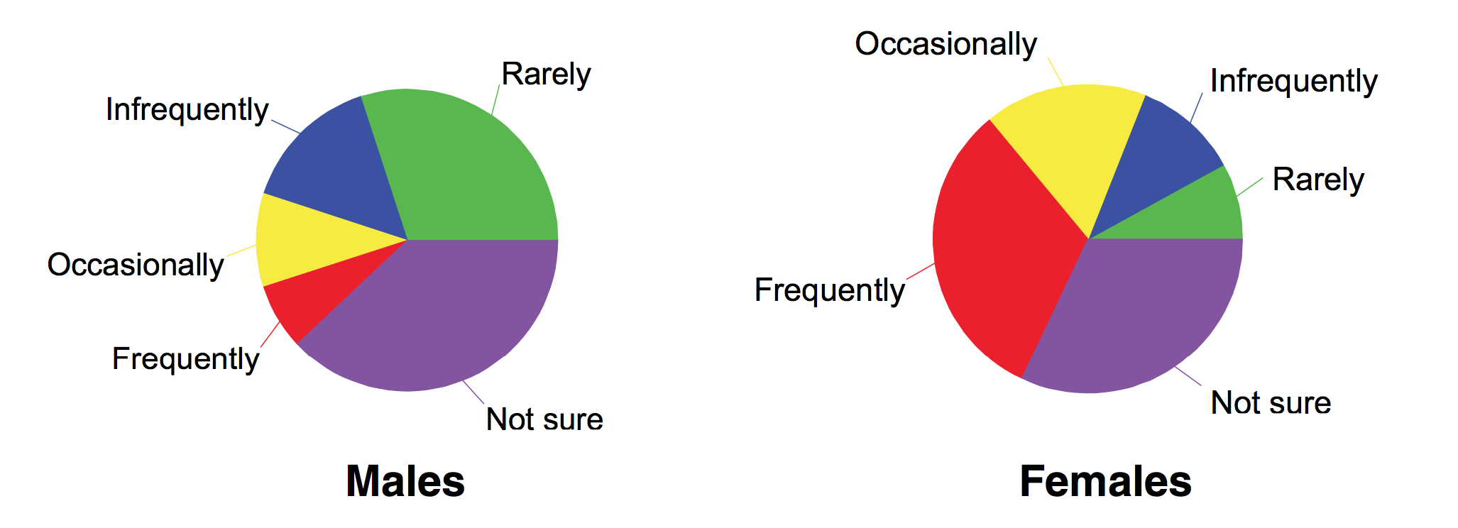
Data
Scales
Response: categorical
Gender: categorical
Statistical Transform
Bin
Geometry Mapping
Data → Interval
Positioning
Stacked
Coordinates
Euclidian → Polar
Aesthetic Mappings
Color: Response
Render

Slide 73
gg/ demo

Slide 74
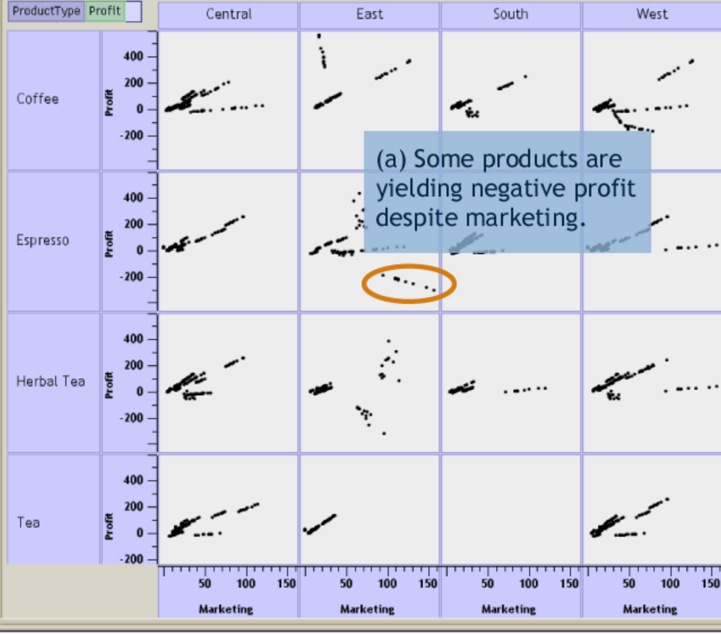
Polaris/Tableau
Notes:
Polaris takes the grammar idea and makes it useful for mere mortals in a constrained scenario: OLAP cube
Problem with grammars are they’re very difficult to learn and use, there is value in constraining the types of sentences to avoid syntactical errors.
In the original paper, their main focus is on an algebra for defining the layout.
Model: plot as a table of graphical cells

Slide 75
Component
Grammar
D3.js
HTML/DOM

Slide 76
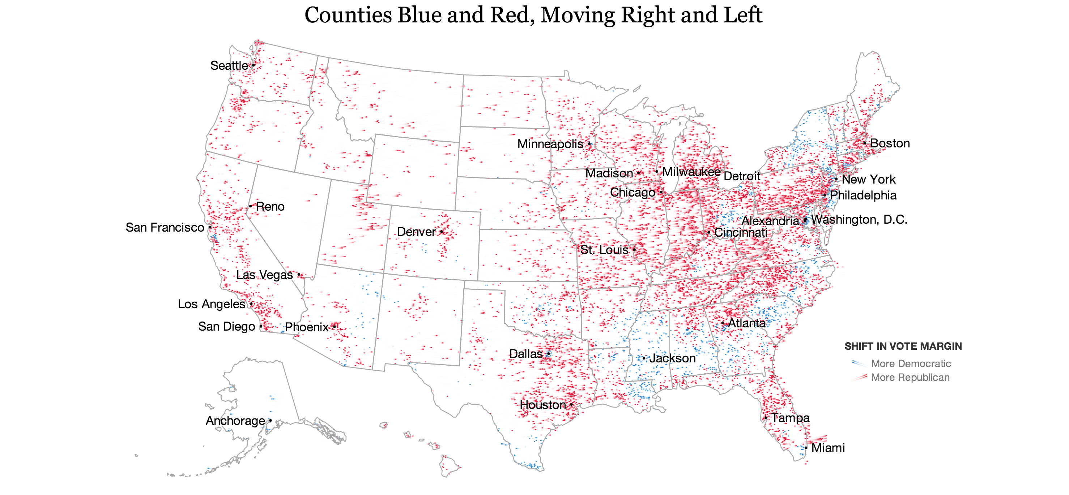
http://www.nytimes.com/interactive/2012/11/11/sunday-review/counties-moving.html

Slide 77
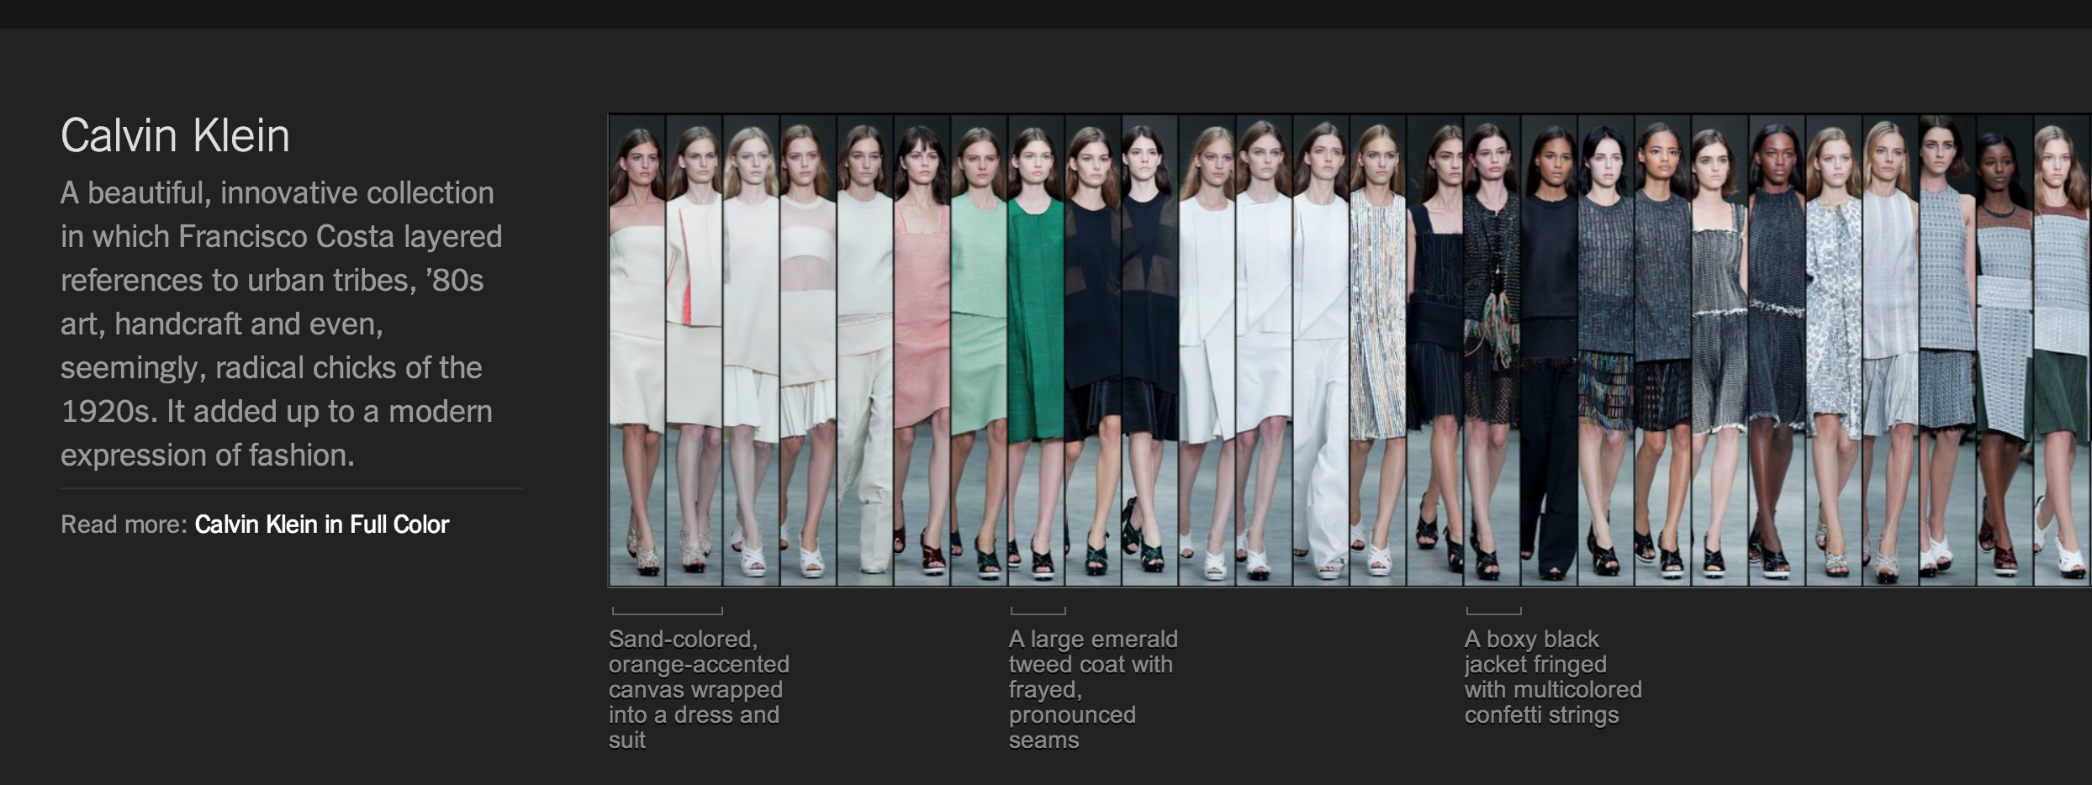
http://www.nytimes.com/newsgraphics/2013/09/13/fashion-week-editors-picks/

Slide 78
Data ⨝ DOM el
Notes:
Explain how outer joins work
Data manipulation happens outside of d3
Layout: cluster, force, hierarchy, histogram, treemap, map
Interaction: brush, zoom
Show demo, then talk about how its implemented

Slide 79
demo

Slide 80
Data ⨝ DOM el
Array Utilities
Formatting
Shapes
Layout
Data Utilities
Color
Scales
Interaction
Notes:
Explain how outer joins work
Data manipulation happens outside of d3
Layout: cluster, force, hierarchy, histogram, treemap, map
Interaction: brush, zoom
Show demo, then talk about how its implemented

Slide 81
Conclude
Graphics are visual statistics
Graphic choice is driven by message
Don’t get in the way of the message
Three models of visualization toolkits

Slide 82
